Slide 1
KHNP’s Supply Chain & Procurement Management
December 2018
Notes:
Good afternoon!!
My name is Seo-kwon LEE from Korea Nuclear Partners dispatched by KHNP.
It is my great pleasure to have an opportunity to make a presentation on KHNP’s supply chain and procurement management in front of distinguished guests here.

Slide 2
CONTENTS
01
Supplier Qualification
02
Procurement Management
03
Long-term Procurement
Notes:
My presentation will cover tree areas.
KHNP’s supplier qualification
Procurement management
Long-term Procurement

Slide 3
1
Supplier Qualification
Notes:
I will start my presentation with KHNP’s supplier qualification.

Slide 4
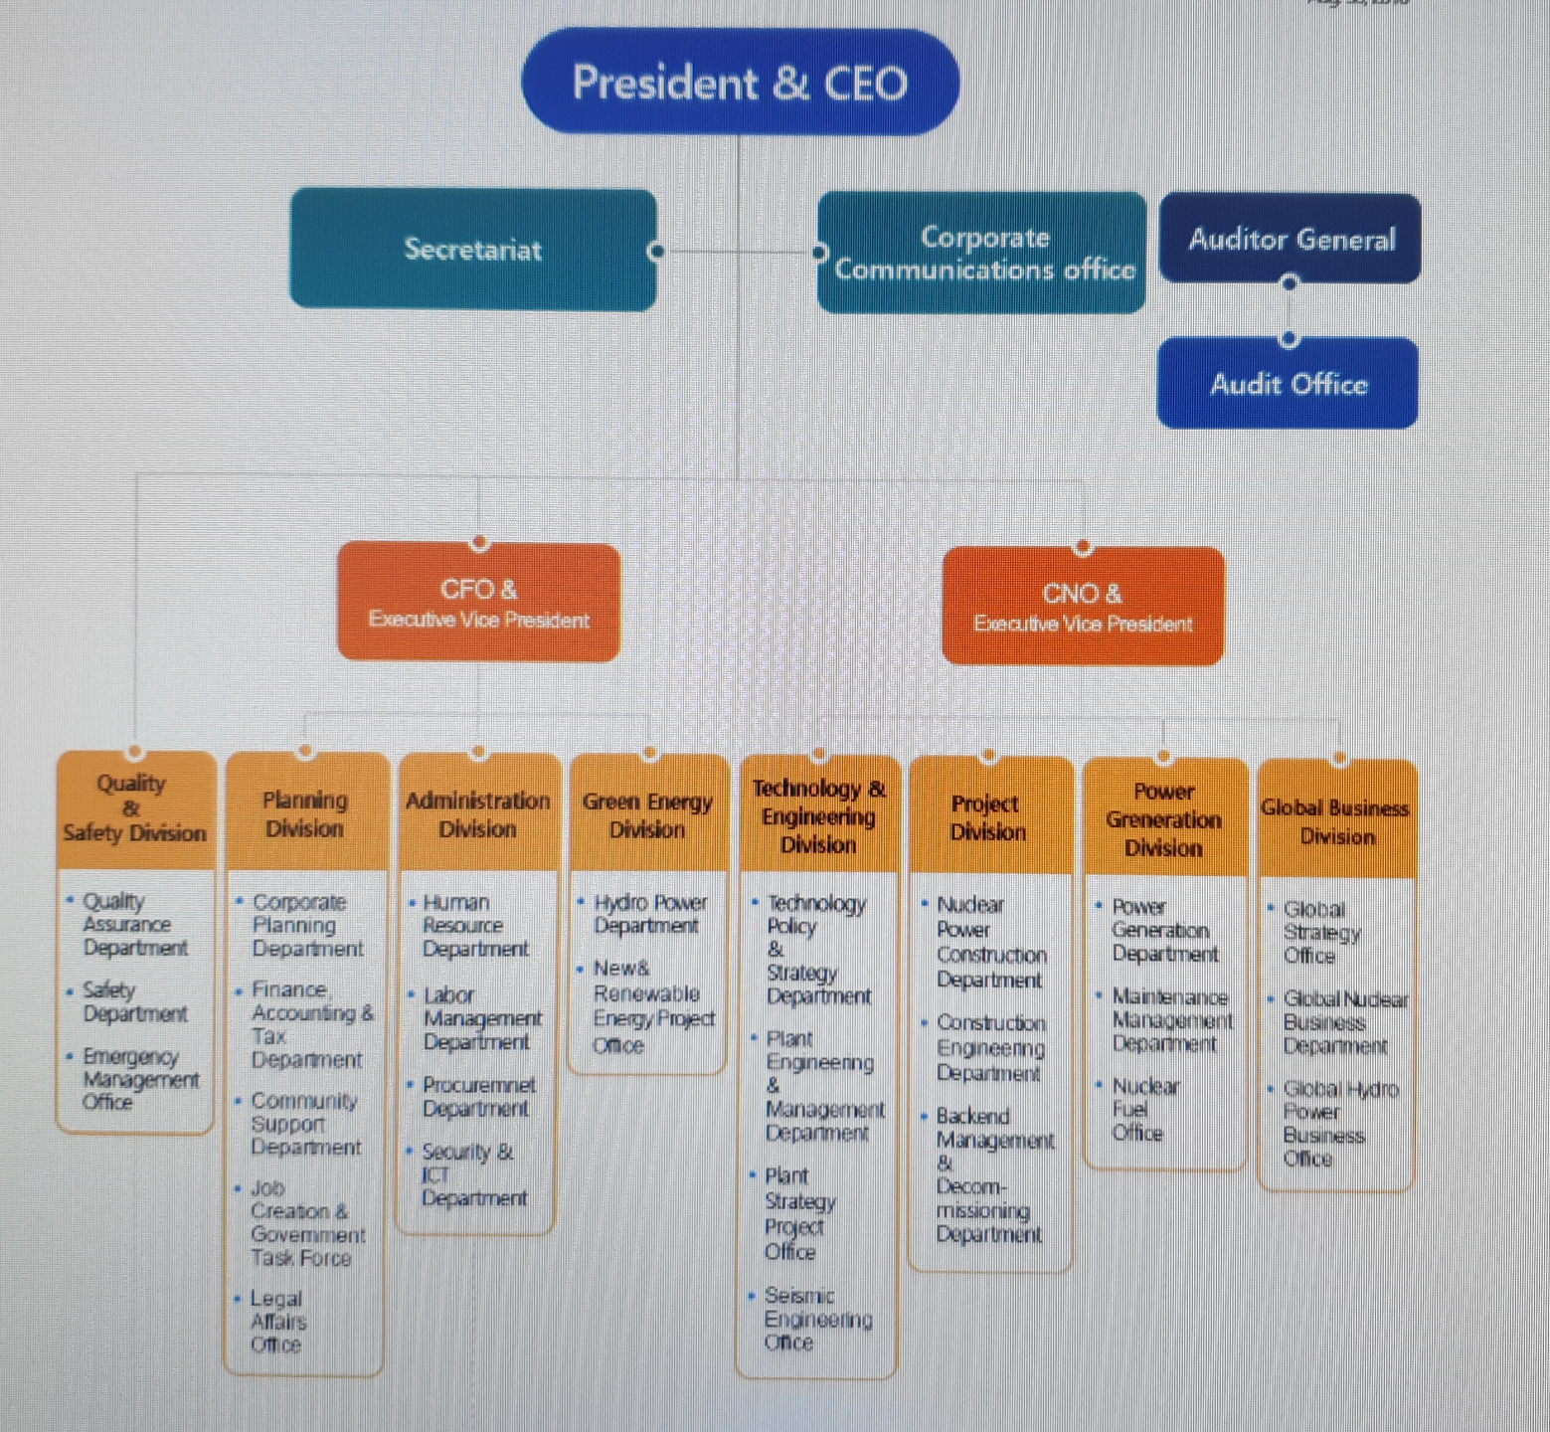
2 Company Profile
2.1
조직도
[ 본사 ]
KHNP Organization
Notes:
First of all, I would like introduce KHNP organization.
Under president and CEO, there are two executive vice presidents, CFO and CNO.
CFO is reported from 4 divisions such as Quality & Safety, Planning, Administration and Green Energy division.
Under CNO, there are four divisions such as Technology & Engineering, Project, Power generation and Global division.
Procurement Department is included in Administration Division.

Slide 5

KHNP Qualification Process
2 Company Profile
2.1
General
Supply Category
조직도
[ 본사 ]
Supply Category
Category | Supply Stage | Equipment | No of Equipment | Qualification Basis | Unit
Major Equipment | Construction | Reactor, Steam Generator RCP, Turbine Generator | - | - | -
BOP | Construction | Heat Exchanger, Valve, Pump, Transformer, Cable, I&C equipment | About 180 | Pkg(*) | Pkg
Spare Part | Maintenance | Valve, Pump, Cable | About 300 | Item(*) | Item
Contract Price
Technical
BOP suppliers have the opportunity to provide the equipment in construction project while Spare Part Supplier can supply the product in operating NPP in KHNP. For convenience, BOP uses the term “Package” while Spare part does the term “Item”
5
Notes:
KHNP categorizes Equipment supply into three parts. Major equipment, BOP(Balance of Plant) and Spare Parts.
Major equipment includes Steam Generator/RCP/Reactor Vessel/Turbine Generator etc.
BOP packages consist of 8 area(Architecture, Civil, …) and 180 Packages and There are 257 suppliers for the whole BOP items
BOP packages are only for construction project.
The last one is spare parts, which are related to the operation and maintenance of nuclear power plant.
There are around 300 items and 372 suppliers for the spare part.
We qualify our suppliers based on package/item.

Slide 6
KHNP Qualification Process
2 Company Profile
2.1
Process
Responsibility
조직도
Self Evaluation
(Quality & Technical Area)
By Supplier
[ 본사 ]
Qualification Process
for foreign
supplier
OK
No
K-Pro
Registration Application
By Supplier
Quality/Technical Document Review
KHNP H/Q
OK
No
Option 1
Evaluation Method Decision(1,2)
(Document Review or Visit Evaluation)
KHNP H/Q
Option 2
Perform Visit Evaluation
Overseas Office
(France, USA)
OK
No
Supplier to be qualified
for 4 years
Disqualified
* K-Pro : KHNP Supplier Management System
Notes:
This slide shows supplier qualification process for foreign suppliers.
Potential suppliers can register for qualification through K-Pro which is KHNP supplier management system. After quality and technical document review, KHNP decides evaluation method such as document review and visit review. For visit evaluation, KHNP overseas Offices such as European and American Office will be responsible for it. If evaluation result is satisfied with requirements, we qualify them for 4 years.

Slide 7
KHNP Qualification Process
2 Company Profile
2.1
Process
Responsibility
조직도
Self Evaluation
(Quality & Technical Area)
By Supplier
[ 본사 ]
Qualification Process
for domestic supplier
OK
No
K-Pro
Registration Application
By Supplier
Quality/Technical Document Review
KHNP H/Q
OK
No
Option 1
Evaluation Method Decision(1,2)
(Document Review or Visit Evaluation)
KHNP H/Q
Option 2
Quality Department
Construction & Engineering Depart
Perform Visit Evaluation
OK
No
Supplier to be qualified
for 4 years
Disqualified
* K-Pro : KHNP Supplier Management System
Notes:
For domestic suppliers, qualification process is similar to that of foreign supplier except visit evaluation conducted by quality and construction/Engineering departments.

Slide 8

KHNP Qualification Process
2 Company Profile
2.1
General
조직도
[ 본사 ]
Company Name/Address/Registration Item
Registration Application Contents
Financial Status/Business/Factory Registration Certificate
Contract Price
Quality
Quality System(Procedure, Manual & Certificate)
Technical
Manpower(R&D, Design, Quality, Production, Test, Inspection)
Procedure(Test, Manufacturing, Inspection)
Equipment(Test, Manufacturing, Inspection)
Program(Computer, Test, Design)
Notes:
In the registration application contents, three main information will be included;
First, general information including financial status, certificates
Second, quality related documents such as procedures, manuals and certificates.
Lastly, technical information including manpower, procedures, equipment, and programs.

Slide 9
Cooperation Status
2 Company Profile
▪ 18 Chapter
(Organization, Design Control,
Inspection, Test Control, Audit)
2.1
1. ASME
NQA-1(*)
조직도
[ 본사 ]
Quality Evaluation
2. KHNP experience
▪ CFSI(Counterfeit Fraudulent Suspect Item)
▪ EQ(Equipment Qualification)
3. Evaluation Checklist
[Scoring based on (1+2)]
▪ Q, A(T,R) Class
(Q : Safety Related, A : Safety Impact)
▪ KHNP Quality Evaluation Criteria
ASME(American Society of Mechanical Engineers) NQA(Nuclear Quality Assurance)-1
Notes:
Let’s go over quality evaluation process.
There are three evaluation criteria such as ASME NQA-1 chapter 18, KHNP experience including CFSI and EQ and checklist according to quality class.

Slide 10
KHNP Qualification Process
2 Company Profile
2.1
Criteria
조직도
Quality Class | Qualified | Disqualified
Q | Score : Higher than 80 No unsatisfactory case among critical question(*) | Score : Lower than 80 More than one(1) unsatisfactory case among critical question
A(T,R) | Score : Higher than 70 No unsatisfactory case among critical question | Score : Lower than 70 More than one(1) unsatisfactory case among critical question
[ 본사 ]
Quality
Evaluation
KHNP assigns the important requirement as critical question such as independence of quality department, CFSI Prevention Process etc.
Even though ASME NQA-1 and ISO9001 quality systems are different, those differences can be adjusted through minor modification in the quality system as European suppliers have well established quality system
Notes:
After evaluation, in case of Q class equipment, score should be more than 80 for qualification, if score is lower than 70 supplier will be disqualified.
In case of A class equipment, threshold score is 70 points.

Slide 11
KHNP Qualification Process
2 Company Profile
2.1
Basis
조직도
[ 본사 ]
Technical Specification
- Essential Certificate(ASME N, NPT, NS, NV)
- Design, Manufacturing, Material & Test Requirements
stipulated in the technical specification
Technical Evaluation
Design
- Experience, Capability(Program, Drawing & Calculation)
- Qualified Manpower, Code & Standard, R&D Center
Manufacturing
- Experience, Equipment Status, Required Certificate, Manpower
Test
- Procedure, Facility & Management, Qualified Manpower
Contract Management
- Post Contract Management Procedure, Supplier Management
* Each package describes the minimum Design/Manufacturing/Test
facility and manpower including experience
Notes:
From now on, I’d like to explain about technical evaluation.
We evaluate five areas mainly, technical specification, design and manufacturing experience and capability. testing and contract management skills.

Slide 12
KHNP Qualification Process
2 Company Profile
2.1
Criteria
조직도
[ 본사 ]
Quality Class | Qualified | Disqualified
Q | Score : Higher than 80 No unsatisfactory case among question | Score : Lower than 80 More than one(1) unsatisfactory case among questions
A(T,R) | Score : Higher than 75 No unsatisfactory case among question | Score : Lower than 75 More than one(1) unsatisfactory case among question
Technical Evaluation
There are requirements such as ASME N stamp in several Packages.
If there is no required certificate, there will not be any possibility to
supply equipment. Cooperation with companies who hold required
certificates are mandatory
KHNP to review the possibility to change evaluation criteria to
incorporate the European Code & Standard when KHNP proceeds
Czech project.
Notes:
Threshold score for qualification is the same as that of quality evaluation, which is 80 points for Q class, 70 points for other classes.

Slide 13


KHNP Qualification Process
2 Company Profile
2.1
Audit & follow-up action
조직도
[ 본사 ]
Quality
Audit
High Quality Equipment Supply
Good Practice
(Sharing with other suppliers)
Recommendation
Nonconformance
Report
Yearly or Special Audit Plan for suppliers
(NQA-1, Supply QA manual)
Notes:
KHNP establishes Audit Plan yearly basis and audits are performed to make sure that KHNP suppliers are maintaining acceptable quality system.
The audits are performed based on the ASME NQA-1(Chapter 1. organization to Chapter 18. Audit) requirement and Quality Assurance Manual
During the audit, non-conformance items and recommendation, good practices are identified. In addition, the follow-up actions are required,

Slide 14
2
Procurement Process

Slide 15
KHNP
Process
2 Company Profile
Process | Entity | Period (M)
1. Prepare Invitation to Tender(ITT) Spec. | KEPCO E&C | 2
2. Purchase Order Request | KHNP | 2
3. Issue ITT | KHNP | 1
4. Request for Technical Evaluation | KHNP | 4~5
5. Issue Technical Evaluation Report | KEPCO E&C | 2~4
6. Confirm Technical Evaluation (Spare Parts & Special Tools) | KHNP | 1
7. Select Technically Acceptable Tenderers | KHNP | 1
2.1
조직도
Procurement Process(1)
[ 본사 ]
Notes:
From this slide on, let me introduce KHNP’s procurement process briefly.
KHNP has subcontractor called KEPCO E&C who prepare ITT specification, technical evaluation.
KHNP as an owner of the NPPs, we are responsible for P.O request, ITT issue, and preferred tenders.

Slide 16
KHNP
Process
Process | Entity | Period (M)
8. Select Successful Tenderer | KHNP | 1
9. Prepare Conformed Specification | KEPCO E&C | 1
10. Contract | KHNP | 1
11. Review & approval of Supplier’s Documents/Start of Manufacturing | KEPCO E&C / Supplier | 30~32
12. Shipping | Supplier
13. Site Inspection, installation and Test | KHNP
Total | - | 45~50
2 Company Profile
2.1
조직도
[ 본사 ]
Procurement Process(2)
Notes:
In addition, KHNP make a contract and is responsible for site inspection, installation and test.
KEPCO E&C prepared conformed specification and review and approval of supplier’s documents.
Usually, from ITT preparation to installation and test it takes about 45 to 50 months.

Slide 17
KHNP
Process
2 Company Profile
2.1
Procurement Engineering Team | Material Control Team | Contract Team | Bidder(Supplier)
조직도
[ 본사 ]
Contract
Process
Internal Request
Purchase Request
Purchase Planning
Tender Notification
(Request For Quotation)
Receipt of bids
(Receipt of Quotation)
Bid Submission
(Quotation)
Technical Review
Commercial Evaluation
(Acceptance)
Technical Specification
Quality Documentation
Price/Terms Negotiation
Open Prices
(Price/Terms Negotiation)
SAP
Acquisition Dept.
Conclusion of Contract
(Issuance of PO)
Award Bidder
(Acknowledgement of PO)
Forwarder :
Receipt of Goods
Shipment
Acquisition
Acquisition Dept. : Sending of Document Records
Request of Payment
( ) private contract
Notes:
This slide shows contract process.
Three organizations in KHNP are involved in contract process. Procurement Engineering team from site initiates to purchase and technical review after receipt of bids or quotations.
Contract team prepares purchase plan, tender notification, commercial evaluation, price open and negotiation and issuance of PO.
Material team arrange forwarder of goods and sending documents and records.

Slide 18
3
Long-term Procurement

Slide 19
KHNP
Process
2 Company Profile
Background
2.1
Securing parts supply chain for stable and safe NPP operation
Pursuing contract awards for repetitive procurement in a timely and effective way.
조직도
[ 본사 ]
Long-term
Contract
Supplier
Contractors : Spare parts suppliers
- Westinghouse, GE and so on
Contents
Commercial conditions, Technical Specification
- Agreement goals, effective date, payment conditions, delivery, applicable
technical criteria
Notes:
Lastly, I will explain about long-term contract of KHNP.
The reason we make a long-term contract is to secure parts for stable operation of NPPs and to pursue to award contracts for repetitive procurement in an efficient way.
Main long-term contract is related to spare parts for NPPs and contractors are Westinghouse, man diesel, Cameron etc.
Contract includes contract periods, payment conditions, delivery and applicable technical criteria.
This is the end of my presentation. Thank you for your attention!

Slide 20
Thank You

